Slide 1
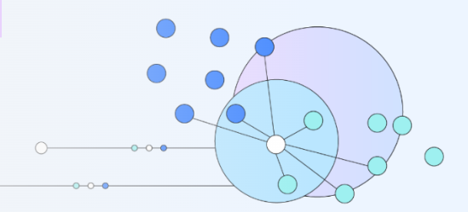
KNN
What is the k-nearest neighbors (KNN) algorithm?

Slide 2
What is the KNN algorithm?
The k-nearest neighbors (KNN) algorithm is a non-parametric, supervised learning classifier, which uses proximity to make classifications or predictions about the grouping of an individual data point.
It is one of the popular and simplest classification and regression classifiers used in machine learning today.
While the KNN algorithm can be used for either regression or classification problems, it is typically used as a classification algorithm, working off the assumption that similar points can be found near one another.

Slide 3
KNN works.
Step-1: Select the number K of the neighbors
Step-2: Calculate the Euclidean distance of K number of neighbors
Step-3: Take the K nearest neighbors as per the calculated Euclidean distance.
Step-4: Among these k neighbors, count the number of the data points in each category.
Step-5: Assign the new data points to that category for which the number of the neighbor is maximum.
Step-6: Our model is ready.

Slide 4
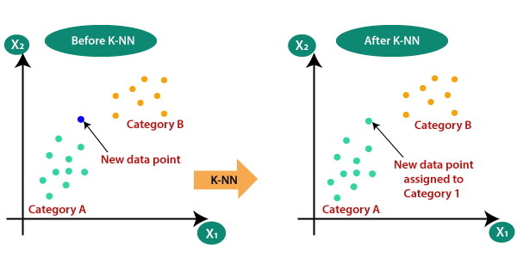
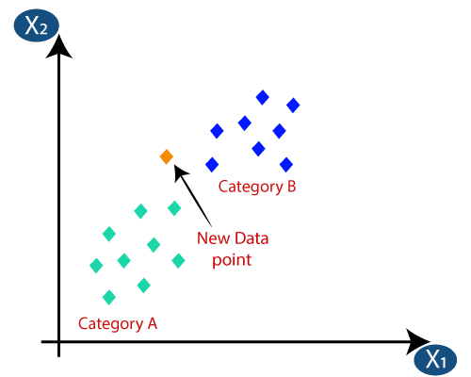

Slide 5
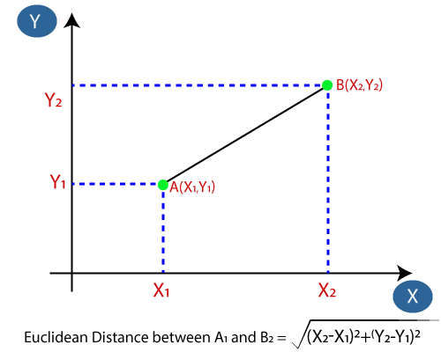

Slide 6
KNN
For classification problems, a class label is assigned on the basis of a majority vote—i.e. the label that is most frequently represented around a given data point is used.
While this is technically considered “plurality voting”, the term, “majority vote” is more commonly used in literature.
The distinction between these terminologies is that “majority voting” technically requires a majority of greater than 50%, which primarily works when there are only two categories.
When you have multiple classes—e.g. four categories, you don’t necessarily need 50% of the vote to make a conclusion about a class; you could assign a class label with a vote of greater than 25%.
The University of Wisconsin-Madison summarizes this well with an example here (link resides outside ibm.com).

Slide 7
Nearest neighbor algorithms are among the “simplest” supervised machine learning algorithms and have been well studied in the field of pattern recognition over the last century.
While nearest neighbor algorithms are not as popular as they once were, they are still widely used in practice, and I highly recommend that you are at least considering the k-Nearest Neighbor algorithm in classification projects as a predictive performance benchmark when you are trying to develop more sophisticated models.
In this lecture, we will primarily talk about two different algorithms, the Nearest Neighbor (NN) algorithm and the k-Nearest Neighbor (kNN) algorithm.
NN is just a special case of kNN, where k = 1.
To avoid making this text unnecessarily convoluted, we will only use the abbreviation NN if we talk about concepts that do not apply to kNN in general. Otherwise, we will use kNN to refer to nearest neighbor algorithms in general, regardless of the value of k.

Slide 8
While kNN is a universal function approximator under certain conditions, the underlying concept is relatively simple. kNN is an algorithm for supervised learning that simply stores the labeled training examples.
hx [i] , y[i] i ∈ D (|D| = n),
During the training phase. For this reason, kNN is also called a lazy learning algorithm.
What it means to be a lazy learning algorithm is that the processing of the training examples is postponed until making predictions 1 – again, the training consists literally of just storing the training data.

Slide 9
Then, to make a prediction (class label or continuous target), the kNN algorithms find the k nearest neighbors of a query point and compute the class label (classification) or continuous target (regression) based on the k nearest (most “similar”) points.
However, the overall idea is that instead of approximating the target function f(x) = y globally, during each prediction,
kNN approximates the target function locally.
In practice, it is easier to learn to approximate a function locally than globally.

Slide 10
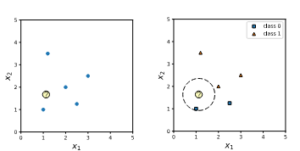

Slide 11
KNN…
Since kNN does not have an explicit training step and defers all of the computation until prediction, we already determined that kNN is a lazy algorithm.
Further, instead of devising one global model or approximation of the target function, for each different data point, there is a different local approximation, which depends on the data point itself as well as the training data points.
Since the prediction is based on a comparison of a query point with data points in the training set (rather than a global model), kNN is also categorized as instance-based (or “memory-based”) method.
While kNN is a lazy instance-based learning algorithm, an example of an eager instance-based learning algorithm would be the support vector machine.
Lastly, because we do not make any assumption about the functional form of the kNN algorithm, a kNN model is also considered a nonparametric model.

Slide 12
Elbow Method in Supervised Machine Learning (Optimal K Value)
The most important step in k-Nearest Neighbor supervised machine learning is to determine the optimal value of K; that is, how many clusters your data should be divided into?
The optimal value of k reduces effect of the noise on the classification, but makes boundaries between classes less distinct.
Elbow method helps data scientists to select the optimal number of clusters for KNN clustering.
It is one of the most popular methods to determine this optimal value of K.
Because the user must specify in advance what k to choose, the algorithm is somewhat naive — it assigns all members to k clusters even if that is not the right k for the dataset.

Slide 13
data = pd.read_csv(‘KNN_Project_Data)
data.head()
While neural networks are gaining popularity in the computer vision and pattern recognition field, one area where k-nearest neighbors models are still commonly and successfully being used is in the intersection between computer vision, pattern classification, and biometrics (e.g., to make predictions based on extracted geometrical features2 ).
Other common use cases include recommender systems (via collaborative filtering3 ) and outlier detection.

Slide 14
In a theoretical manner, we can say that a distance measure is an objective score that summarizes the difference between two objects in a specific domain. There are several types of distance measures techniques but we only use some of them and they are listed below:
1. Euclidean distance
2. Manhattan distance
3. Minkowski distance
4. Hamming distance

Slide 15
Euclidean Distance
We mostly use this distance measurement technique to find the distance between consecutive points. It is generally used to find the distance between two real-valued vectors. Euclidean distance is used when we have to calculate the distance of real values like integer, float, etc… One issue with this distance measurement technique is that we have to normalize or standard the data into a balance scale otherwise the outcome will not preferable.
Let’s take an example of a 2-Dimensional vector and take a geometrical intuition of distance measures on 2-Dim data for a better understanding.

Slide 16
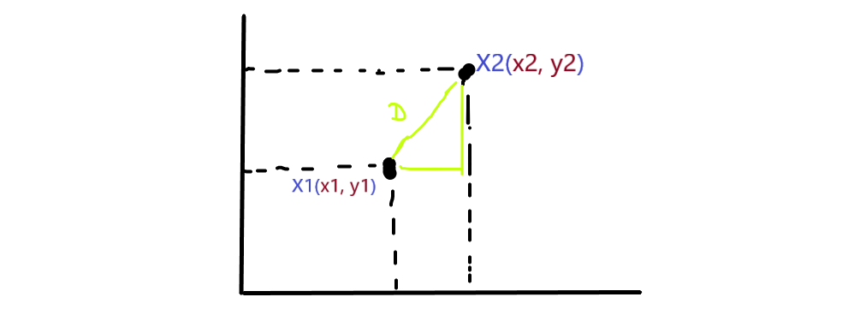

Slide 17

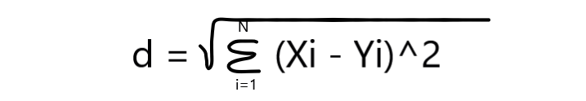
From the above image, you can see that there are 2-Dim data X1 and X2 placed at certain coordinates in 2 dimensions, suppose X1 is at (x1,y1) coordinates and X2 is at (x2,y2) coordinates. We have 2-dim data so we considered F1 and F2 two features and D is considered as the shortest line from X1 and X2, If we find the distance between these data points that can be found by the Pythagoras theorem and can be written as:
You already know that we are finding the distance or we can say the length of any 2 points, so we in vectorize from we can write that as d = || X1 – X2 ||
Suppose we take D-dimensional vector it means X₁ belongs to R^{d} (X₁∈R^{d}) and also X₂ belongs to R^{d} (X₂∈R^{d}) so the distance between X1 and X2 is written as:

Slide 18
Example
Let’s take a simple and basic example to illustrate the above mathematical equation.
Suppose the vector X1 and X2 coordinates are in 2-Dim,
X1(x₁, y₁) = X1(3, 4)
X2(x₂, y₂) = X2(4, 7), as you can see in the image.
So these are a 2-Dim vector so our eucledian distance mathematical equation for finding the distance between X1 and X2 is:
distance = sqrt( (x₂-x₁)² + (y₂-y₁)² )

Slide 19
When we put our coordinates in the equations,
distance = sqrt( (4-3)² + (7-4)² )
distance = sqrt( 1+3² )
distance = sqrt( 10 )
distance = 3.1 (approx)
https://www.analyticsvidhya.com/blog/2021/08/how-knn-uses-distance-measures/

Slide 20
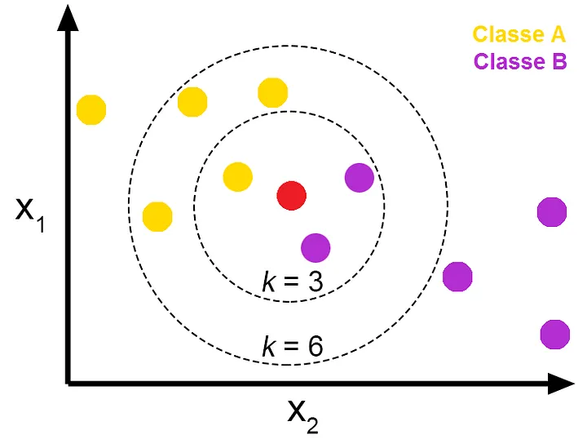

Slide 21
BRIGHTNESS | SATURATION | CLASS
40 | 20 | Red
50 | 50 | Blue
60 | 90 | Blue
10 | 25 | Red
70 | 70 | Blue
60 | 10 | Red
25 | 80 | Blue
The table above represents our data set. We have two columns Brightness and Saturation. Each row in the table has a class of either Red or Blue.
Before we introduce a new data entry, let's assume the value of K is 5.

Slide 22
How to Calculate Euclidean Distance in the K-Nearest Neighbors Algorithm
BRIGHTNESS | SATURATION | CLASS
20 | 35 | ?
We have a new entry but it doesn't have a class yet. To know its class, we have to calculate the distance from the new entry to other entries in the data set using the Euclidean distance formula.
Here's the formula: √(X₂-X₁)²+(Y₂-Y₁)²
Where:
X₂ = New entry's brightness (20).
X₁= Existing entry's brightness.
Y₂ = New entry's saturation (35).
Y₁ = Existing entry's saturation.

Slide 23
Distance #1
For the first row, d1:
BRIGHTNESS SATURATION CLASS
40 20 Red
d1 = √(20 - 40)² + (35 - 20)²
= √400 + 225
= √625
= 25

Slide 24
We now know the distance from the new data entry to the first entry in the table. Let's update the table.
BRIGHTNESS | SATURATION | CLASS | DISTANCE
40 | 20 | Red | 25
50 | 50 | Blue | ?
60 | 90 | Blue | ?
10 | 25 | Red | ?
70 | 70 | Blue | ?
60 | 10 | Red | ?
25 | 80 | Blue | ?

Slide 25
Distance #2
For the second row, d2:
BRIGHTNESS SATURATION CLASS DISTANCE
50 50 Blue ?
d2 = √(20 - 50)² + (35 - 50)²
= √900 + 225
= √1125
= 33.54

Slide 26
Let's rearrange the distances in ascending order:
BRIGHTNESS | SATURATION | CLASS | DISTANCE
40 | 20 | Red | 25
50 | 50 | Blue | 33.54
60 | 90 | Blue | 68.01
10 | 25 | Red | 10
70 | 70 | Blue | 61.03
60 | 10 | Red | 47.17
25 | 80 | Blue | 45
BRIGHTNESS | SATURATION | CLASS | DISTANCE
10 | 25 | Red | 10
40 | 20 | Red | 25
50 | 50 | Blue | 33.54
25 | 80 | Blue | 45
60 | 10 | Red | 47.17
70 | 70 | Blue | 61.03
60 | 90 | Blue | 68.01

Slide 27
As you can see above, the majority class within the 5 nearest neighbors to the new entry is Red. Therefore, we'll classify the new entry as Red.
Since we chose 5 as the value of K, we'll only consider the first five rows. That is:
BRIGHTNESS | SATURATION | CLASS | DISTANCE
10 | 25 | Red | 10
40 | 20 | Red | 25
50 | 50 | Blue | 33.54
25 | 80 | Blue | 45
60 | 10 | Red | 47.17

